Slide 1

Predictive Maintenance of Aircraft Engine
Raja Muthu
IE7374 Sensor Analytics in engineering system

Slide 2
1. Introduction
2. Data Source
3. Data Cleaning
4. Results
5. Conclusions

Slide 3

Predictive Maintenance
Predictive maintenance techniques are designed to help determine the condition of equipment estimate when maintenance should be performed¹.
Predictive maintenance uses historical and real-time data from various parts of machine operation to anticipate problems before they happen.
Advantages of Predictive maintenance
Production hours lost due to maintenance
Cost of spare parts and supplies
Time the equipment is being maintained
Predictive maintenance seeks to define the best time to do work on an asset so maintenance frequency is as low as possible and reliability is as high as possible without unnecessary costs.

Slide 4
Need for predictive maintenance in Aircraft Engine
Operational safety improvements
Increasing equipment usage
Avoiding unscheduled maintenance
Change operational characteristics (such as load) which in turn may prolong the life of the component.

Slide 5
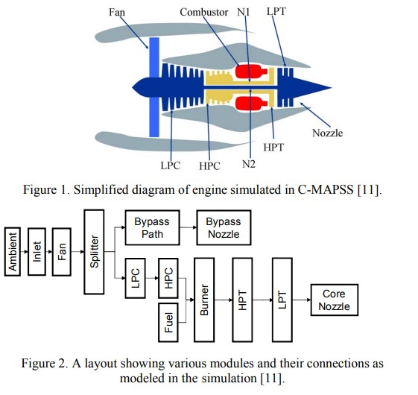
Data Source
Damage Propagation Modeling for Aircraft Engine Run-to-Failure Simulation – 2008 PROGNOSTICS AND HEALTH MANAGEMENT
The datasets are unlabeled containing 4 different subsets of train and test files
Each subset is simulated for a different condition
Training set contains 20631 rows of data from 100 engines
Test Data has 16596 rows of data.

Slide 6
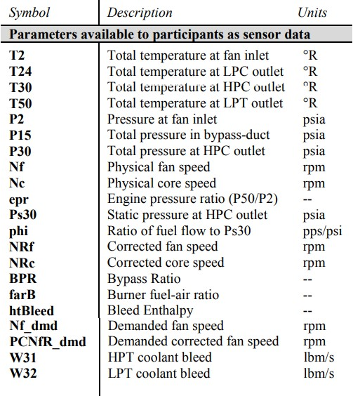
Data Generation
Commercial Modular Aero Propulsion System Simulation
C-MAPSS is a tool for simulating a realistic large commercial turbofan engine.
The software is coded in the MATLAB® and Simulink® environment, and includes a number of editable input parameters that allow the user to enter specific values of his/her own choice regarding operational profile, closed-loop controllers, environmental conditions, etc.
The inputs include fuel flow and a set of 13 health-parameter inputs that allow the user to simulate the effects of faults and deterioration in any of the engine’s five rotating components (Fan, LPC, HPC, HPT, and LPT)

Slide 7
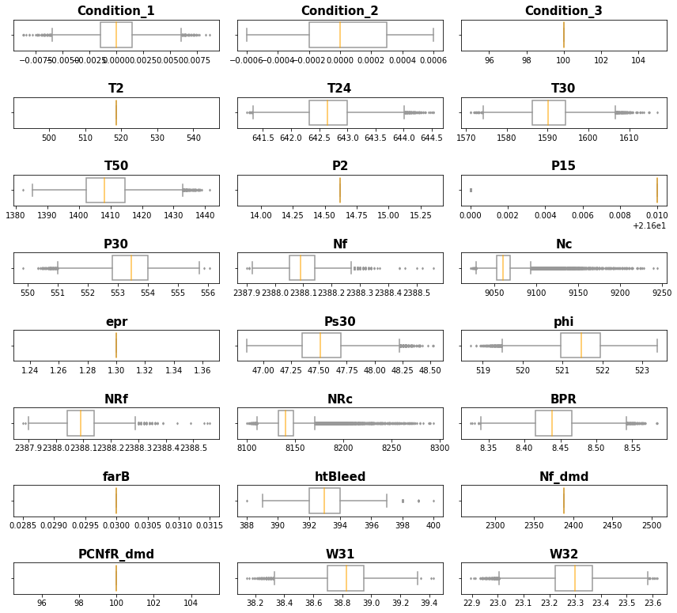
Feature selection
Here we have boxplot of all sensor measurement of training dataset plotted together.
As we can observe some of the metrics are constant like Condition-3, T2, P2 and etc.,
This content metrics don’t give us relevant information so we can eliminate/drop them.

Slide 8
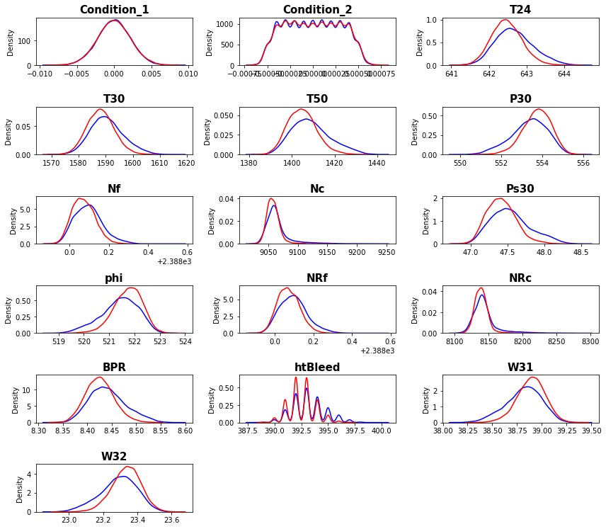
Feature selection cont.
Here we have distribution plot of both training and test data.
The metrics which doesn’t give necessary information are dropped.
we can see both training(Blue) and test data have a very similar spread.

Slide 9
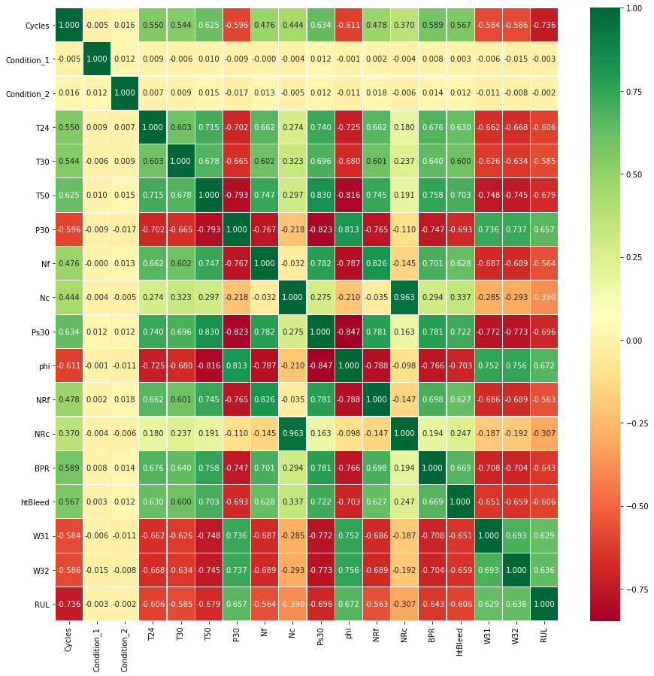
Remaining Useful Life(RUL)
RUL is calculated as,
RUL= Max_Cycles – Current Cycle
We can see from the correlation plot that RUL has strong negative correlation between many of the metrics, meaning has the sensor reading increases the RUL decreases or vice versa.
Which further confirms the engine is prone to failure at high critical values of temperature and pressure.

Slide 10
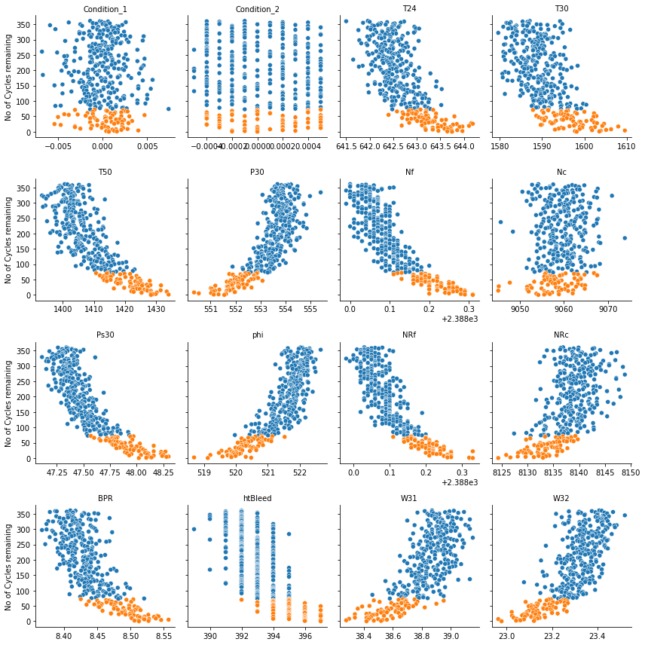
Adding label
Using RUL and MAX Cycles of an engine the percentage of engine lifecycle is calculated
If the engine is left with 20% of it’s life it is given a label as 1
else it is labelled as 0
The Plot on the left is plotted for a random engine from training data.
As we can see the pattern is same as what we observed in the previous correlation plot

Slide 11
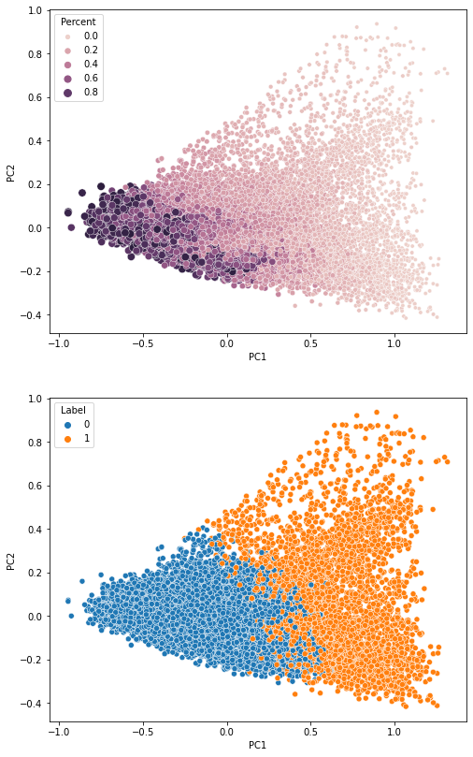
Principle Component Analysis
Only using the 14 features selected before.
Data is normalized
To observe the underlaying trend in the data PCA is performed.
The Plot on the right is for the training data, which is labeled as per the previous assumption

Slide 12
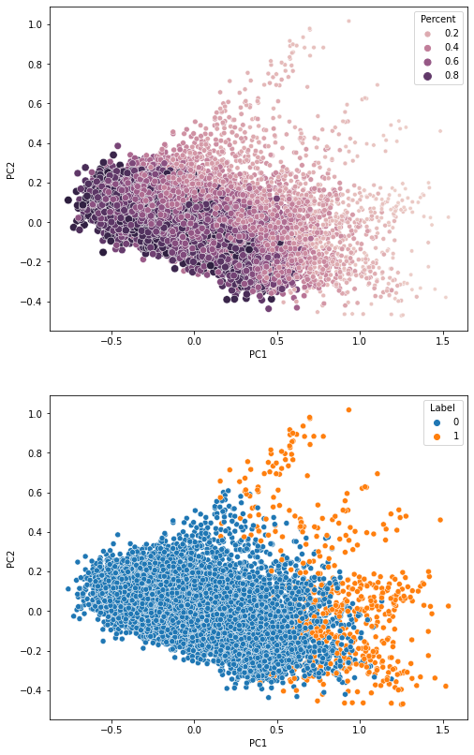
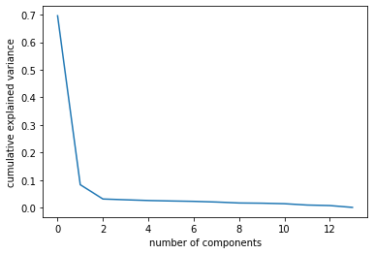
Principle Component Analysis
This is the PCA plot of test Data
We can there are not many orange points, as this data was simulated before the occurrence of failure.

Slide 13
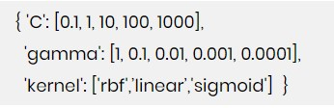
Classification model development
The performances of the models are dependent on their hyperparameters
Grid Search is a process of performing hyperparameter tuning in order to determine the optimal values for a given model.
Have to try different combination of parameter to select the best combination which gives optimal solution.
Gridsearchcv function helps to loop through predefined combinations of hyperparameters and evaluates the model for each combination using the Cross-Validation method.

Slide 14
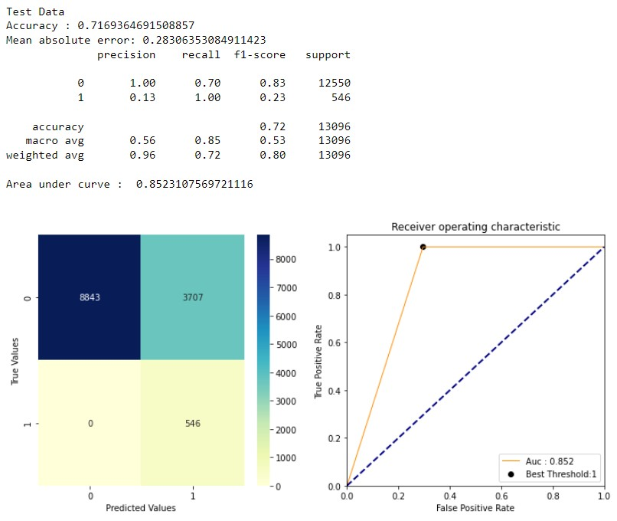
Logistic Regression model
Logistic Regression is the simple classification model
Performed cross validation with multiple solver and regularization value with 5-fold cross validation
Best outcome is for Liblinear and C=10
Accuracy of Training Data : 95.3%

Slide 15
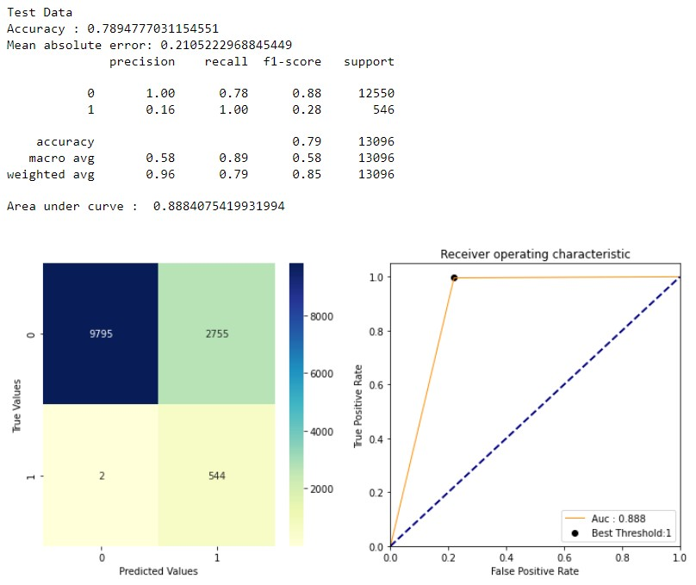
Support Vector Machine
Applied different kernel and regularization parameter
The model performs best for polynomial kernel and C= 1
Accuracy of Training Data : 95.9%

Slide 16
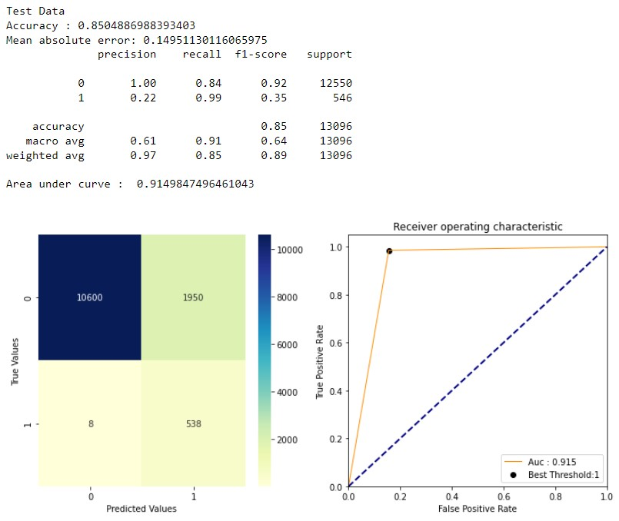
Random Forest model
Designed model for multiple number of estimators like 100,250,500,750
The best performance is for 500 estimators
Accuracy of training dataset is 100%

Slide 17
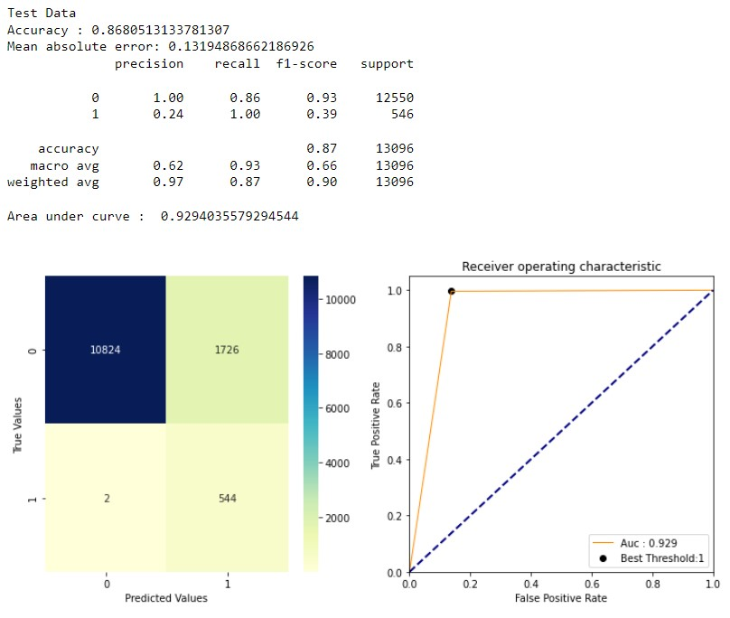
K-nearest neighbors
Compared models for nearest neighbor ranging from 1 to 18 and 5-fold cross validation
The model with 17 neighbors gives the highest accuracy
Accuracy of Training Data : 95.8%

Slide 18
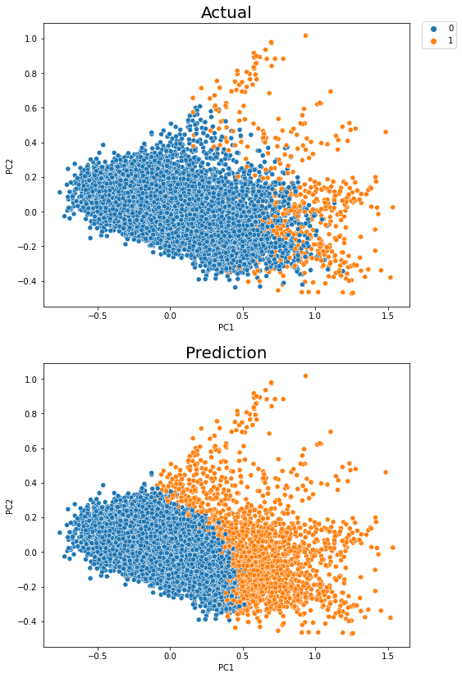
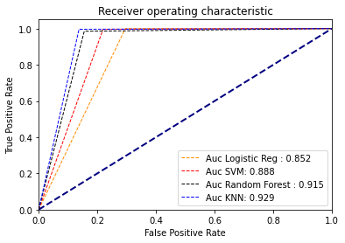
Conclusions
KNN model gives the best results based on accuracy on test data and AUC curve.
The Plot on the right is plotted with the PCA results to visualize the decision boundary of KNN classifier and we can see a clear separation between 1 and 0

Slide 19
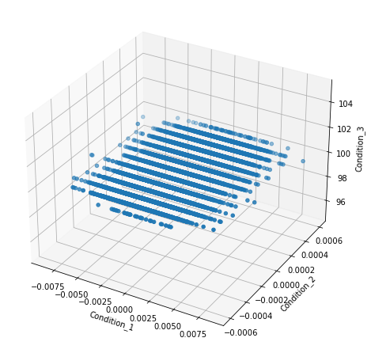
Discussions
On the right we have the Scatter plot of 3 different conditions which monitor the aircraft performance.
We can clearly observe the Condition 3 remains constant and Conditions 1 and 2 varies very slightly.

Slide 20
END

